Slide 1
Common Tools of Computational Science
Computational Biosciences Club at UNC Chapel Hill
March 1, 2022

Slide 2
What this workshop is (and isn’t)
This workshop is:
A way to get a brief overview of common tools and techniques used in computational biosciences
For anyone interested or currently doing computational research
A jumping off point to learn more and develop your skillset in a direction that suits you best
This workshop is NOT:
A deep dive into specific computational tools or methods
The end-all be-all of computational tool knowledge

Slide 3
List of resources
https://github.com/Computational-Biosciences-Club/computing_resources/blob/main/learning_links.md
Add more if you find useful resources!

Slide 4
Structure of this workshop
~1 hour of talk
During this, ask questions in the chat
Moderators will try to answer in chat as much as possible
If a question is useful to provide context for the whole audience, moderators will throw it to me and I’ll answer out loud
~30 mins of Q&A
Try not to be too specific, but let’s talk problems and questions you have
Good: “I’m trying to throw together a sequencing pipeline, what framework would you suggest I use and how should I think about structuring it?”
Not so good: “I’m trying to do WGS on a non-model organism, what’s the best aligner?”

Slide 5
What tools are (mostly) common to everyone?
Text editors/IDEs
Bash/*nix systems
HPC systems/SLURM/Cloud Computing
Git/Github
Containerization/Conda
Workflow languages

Slide 6

VS Code is my favorite workstation
https://code.visualstudio.com
FOSS, run by Microsoft, regularly contributed to by community
Huge number of extensions for languages, processes, formatting, etc
Complete workstation
Text editor
Docker and Conda environment integration
Jupyter notebook support
Multi-terminal support
Filesystem explorer
Directly connects to SSH and allows you to do all of this on LongLeaf
Git/GitHub integration with easy diff manipulation

Slide 7
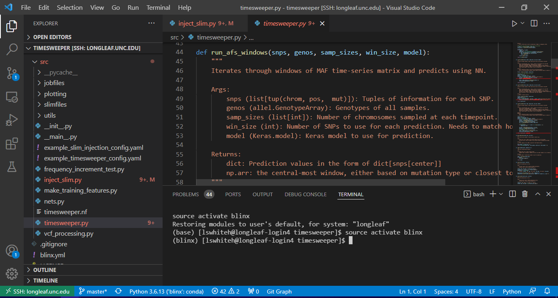

Slide 8

Unix/Linux
Linux is a FOSS clone of Unix
Unix – Bell Labs in 1960s
Linux – Linus Torvalds in 1990s
Linux is an OS
Controls filesystems, sits between hardware and software
Most every system you encounter for computational work will be some form of Linux
Default shell is Bash
Shell: how a user interacts with the operating system

Slide 9
Bash as a Command Line Interface (CLI)
Gives access to running tools, moving and manipulating files, most anything you want to do at a top-level of a system
Wide variety of tools and commands built-in for common tasks:
File management and I/O (ls, cat, >, <, |)
Globbing and wildcards (regex, *)
Searching and summarizing (find, grep)
Can customize your shell variables and environment using ~/.bashrc
Aliases
Commands to run at startup
Export paths

Slide 10
Bash as a scripting language
Take all the useful parts of the CLI, and make it even more powerful
Math, loops, variables, functions, shell expansion and substitution
Built-in tools:
sed – text transformations like substitutions and deletions (easy to pair with a pipe from grep)
awk – an entire scripting language for file manipulation (this could be an entire lecture)
Parallelization through &, xargs, or gnu parallel

Slide 11
LongLeaf and Dogwood
Off campus access with VPN: link to knowledgebase article
4 Filesystems
/proj/ - Labs are given space, medium speed, long-term project storage
/pine/ - Each user gets space as needed, fastest speed, untouched items removed after a few weeks
/overflow/ - If your lab is hardcore and needs more space, medium speed, least priority in terms of upkeep from ITS
/ms/ - Used to be tape storage, think they upgraded, slowest speed, *do not work from here, only transfer to and from*
Highly suggest using GLOBUS to move files between filesystems or between local/cloud and LongLeaf
https://its.unc.edu/research-computing/techdocs/getting-started-with-globus-connect/

Slide 12
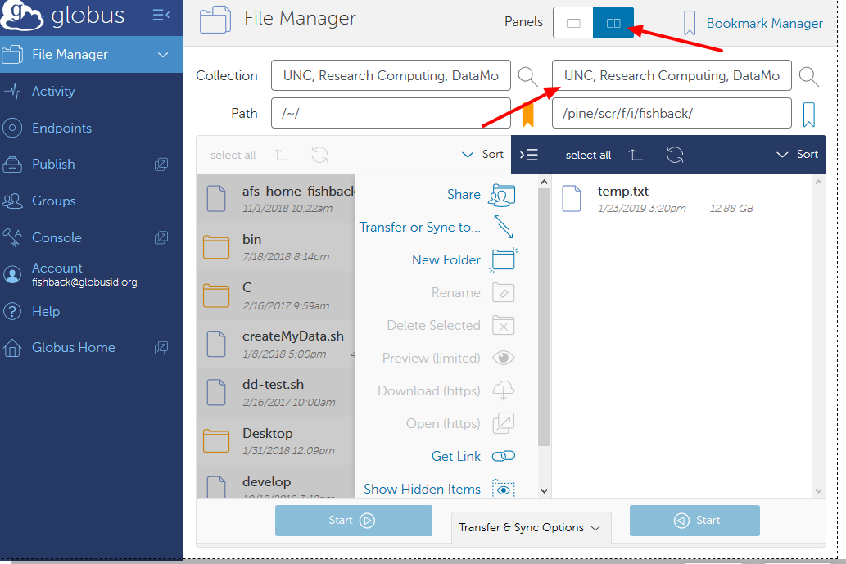

Slide 13
HPCs and Cloud Computing
Desktops/laptops just aren’t powerful enough
Storage space
RAM
CPUs and GPUs
ITS provides Longleaf and Dogwood
Easy to access anywhere with VPN
Lots of resources, easy to get job time
Stable for tasks that require tons of uptime
Other avenues exist for getting HPC access such as XSEDE (https://www.xsede.org)
Cloud computing is the industry standard, many concepts from HPC computing carry over

Slide 14
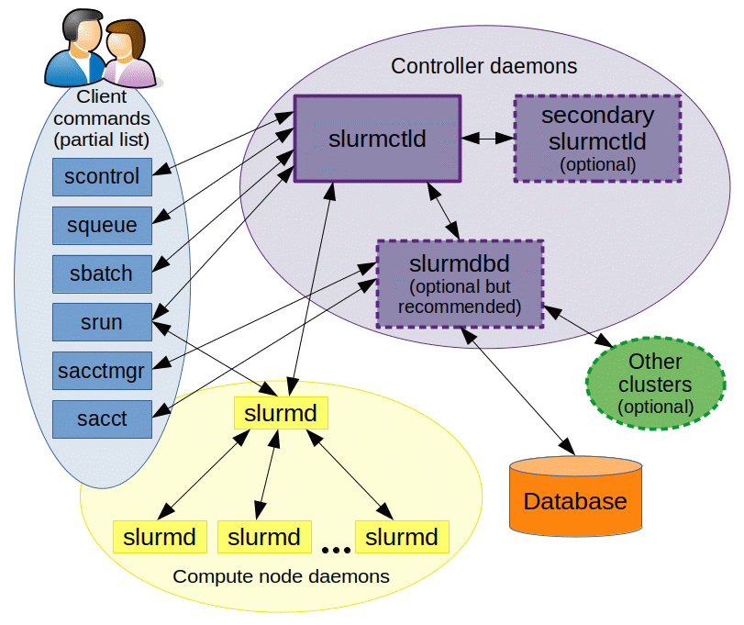
Job management systems (SLURM, TORQUE, PBS)
Allow many users to utilize resources on compute resources
Schedule jobs based on resources requested to allow for a more fair
LongLeaf and Dogwood use SLURM (https://slurm.schedmd.com/documentation.html)
Allows for starting, monitoring, ending jobs both serial and array
Highly scalable, open source

Slide 15
Useful LongLeaf and SLURM tips and concepts
ITS asks that you try to schedule jobs that last around an hour on LongLeaf
Test your jobs, run in batches as necessary to hit around this time for optimal efficiency without making sysadmins upset
Don't over-request
Shared resource, everyone's trying to use it!
Lot of useful commands for checking on job stats if you run a test (sacct –e)
More ressources requested also means slower start
Array jobs are incredibly useful
Can use the $SLURM_ARRAY_TASK_ID as a file identifier, to make batches of runs with a loop, etc

Slide 16
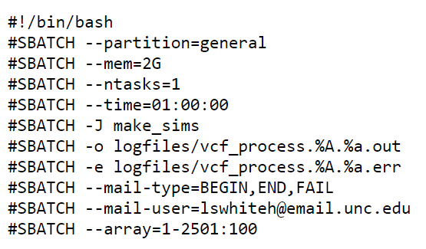
Example SLURM header for LongLeaf
SLURM will open a new shell
Different partitions for cpu/gpu/bigmem
RAM required
Number of tasks (useful if using &), cores and CPUs default to 1 per task
Time in format <days>-<hours>:<minutes>:<seconds>
Job name (useful for identifying in queue)
Write stdout to file
Write stderr to file
Get emailed whenever stuff happens
Email acct to send messages
Run 2501 tasks, but only submit a job for each 100th number
https://slurm.schedmd.com/pdfs/summary.pdf

Slide 17
Array jobs: the high-throughput hero
Problem: Need to run 500 pipelines, would take forever to do one by one
Solution: Specify an array of 1-500, use $SLURM_ARRAY_TASK_ID to index the input file to run from a list
Benefits:
Highly parallellized
Runs are independent of each other (one fail won't ruin all)
Could also index every 5 IDs and loop 5 at a time using seq
Useful tutorial on SLURM array jobs

Slide 18
Submitting a job
From the command line
$ sbatch <slurm flags> --wrap=“<command>”
With a script
Create a job script, put header at top
$ sbatch <job_script.sh>
You’ll receive emails according to your header settings
Logfiles will write as the job runs
You can monitor your jobs with the command squeue -u <onyen>

Slide 19
Version control: checkpoints for code
Checkpoints are useful for obvious reasons
If your system crashed tomorrow, what would happen to your project?
Could you find the exact code you wrote a month ago and then deleted because you thought you didn’t need it?
You found a bug, when was it introduced and how long has it been affecting results?
Branching allows you to test and experiment without breaking progress on the main code
Collaboration is streamlined when everyone is on the same page

Slide 20

Git
Version control – allows you to track and manage the history of a project in a "repository"
One of the keys to true reproducibility – both for you and your peers
Allows you to revert any tracked part of your repository whenever needed
Integral component of every software developer's workflow
https://juristr.com/blog/2013/04/git-explained/

Slide 21

GitHub/GitLab
Service for storing and collaborating on repositories
Allows for teamwork, community development
Issues, wikis, tracking
Automated processes such as unit and integration testing
Great home for projects
Nice README presentation, tagging, searching, pull requests
Private/public repos

Slide 22
Example git use – adding a commit and pushing to a GitHub repo
Make edits to files in the repository
script.py, README.md
Add changes to staging area (prep them, create diff)
$ git add script.py README.md
$ git add .
Commit changes (save diff to repository)
$ git commit –m “<describe changes>”
Push to GitHub for remote updates
$ git push –u origin master

Slide 23
Reproducibility in Computational Science
Computational work can be 100% reproducible
Why should you try for reproducibility?
Good science is replicable, proves authenticity
Always the possibility results will need to be repeated by yourself or others
Tool builders must prove their tools are consistent
Aim to make reproducibility as simple as possible
How easy would it be for your collaborators to run your code?

Slide 24

Conda: environments for scientific computing
Open source package and environment management system
Mainly aimed at Python, but also allows for R packages and other software tools
Pulls from a series of repositories that developers upload to
conda base, conda-forge, bioconda, etc
Allows you to create separated "buckets" of packages and software
Minimizes compatibility issues
Will also automatically determine necessary prerequisites from packages you want to install and automatically include those in the process
Is NOT a container, but does give some of the benefits of one
Allows for reproducible environment sharing

Slide 25
Basic conda environment usage
Make
Make an environment from scratch
$ conda env create -n comp-biosci-env
Activate
Activate an environment
$ conda activate comp-biosci-env
Install
Install a package
$ conda install -c conda-forge scikit-learn
Export
Export your environment to share with others
$ conda env export > comp-biosci-env.yaml
Load
Make an environment from env yaml
$ conda env create -f comp-biosci-env.yaml
Leave
Leave an environment
$ conda deactivate

Slide 26

Docker/Singularity and Containerization
Containerization – packaging OS, software, and dependencies for a single executable package ("container") independent of the system running it
Is the de facto standard for reproducible code, can run anywhere if Docker/Singularity is installed
Docker and Singularity are roughly interchangeable
Singularity is more common in academic HPCs because of security
Docker is the industry standard
You can run Docker images on Singularity, so always a good idea to write for Docker first

Slide 27
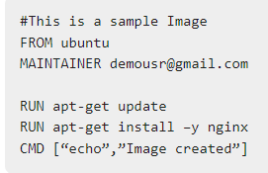
Dockerfile basics
Describes steps necessary to build container image and run desired commands
Can be very simple – or very complex depending on the needs
Build image – templates to build containers from
$ docker build –t <image_name>:<tag_name> <Dockerfile dir>
Run image as a container
$ docker run <image_name>
Run a dockerfile with Singularity
$ singularity shell <image_name>
$ singularity run <image_name>
https://www.tutorialspoint.com/docker/docker_file.htm

Slide 28
Workflows: the Good the Bash and the Ugly
Lot of computational science is stringing tools and processes together
If it’s so critical, why not use the best tools?
Workflow managers have come a long way
Scalability and parallelization
Resume/restart/conditional error handling
Logical flow between processes reflected in the workflow
System agnostic
Modular and robust to complex tasks
Bash is fine for simple tasks, but what more robust options exist?

Slide 29

GNU Make
Built for generation of executables and other non-source files
Logic can be exploited naturally into workflow development
Follows consistent format for all tasks
target: dependencies
commands
Target – either name of the rule (like a function) or the file to be made
Dependencies – other files or targets that need to run in order for this one to be able to
Commands – any processes that need to occur to finish <target>
Logic is input/output based, and conditional on pre-existing targets
Better for doing installs and setup after download than workflow dev

Slide 30

Snakemake
Built on the same logical flow as GNU Make
I/O and File-based logic
Integrates well with HPC/Cloud systems
Per-rule Conda env or container
Built on Python
Syntax is identical
Python scripting integrated with Snakemake code
Abstracts out ID handling to wildcard system
Steep learning curve, but very powerful once learned
glob_wildcards()
Preferred in academia

Slide 31

Nextflow
Seqera Labs
Open source
Language agnostic
Fast to get up and running
Readable and easy to write
Process (function) based logic
Easier to grok than I/O-based workflows

Slide 32
Example Scenario
Download input.txt
Cut out the 2nd column from input and write to file intermed.txt
Run process.py
Which outputs output.png

Slide 33
Bash version
wget input.txt
cut -f2 input.txt > intermed.txt
python process.py -i intermed.txt -o output.png

Slide 34
Makefile version
all: output.png
input.txt:
wget input.txt
intermed.txt: input.txt
cut -f2 input.txt > intermed.txt
output.png: intermed.txt
python process.py -i intermed.txt -o output.png

Slide 35
Snakemake version
rule all:
input:
"output.png"
rule download:
output:
“input.txt”
shell:
"wget {output}"
rule cut:
input:
“input.txt”
output:
“intermed.txt”
shell:
"cut -f2 {input} > {output}"
rule run_script:
input:
“intermed.txt”
output:
“output.png”
shell:
python process.py -i {input} -o output.png

Slide 36
Nextflow version
infile = Channel.fromPath(“input.txt”)
process download {
output:
path input_data into infile
shell:
'''
wget ${input_data}
'''
}
process cut {
input:
path input_data from infile
output:
path “intermed.txt” into intermed_file
shell:
'''
cut -f2 ${input_data} > ${intermed_file}
'''
}
process run_script {
input:
path intermed_data from intermed_file
output:
path “output.png” into output_file
shell:
'''
python process.py –i ${intermed_file} –o ${output_file}
'''
}

